Slide 1
Social Media 101
August 26, 2021

Slide 2
Agenda for today
What to think about before doing social
Some commonalities across different platforms
Quick tour of major platforms
Notes:
So what I am going to do today is provide a “101” to talk about some of the very basics of social media. You really could do an indepth webinar on any number of the topics in this presentation, but I’m aiming for breadth instead of depth to help give you an overview of what some of your options are when it comes to social media.
First, I’ll be going through a few things you should think about before you even start doing social
Second, a few basic “things to know” that apply to most of the different platforms you might be using
And third, a quick tour of some of the major platforms with just a handful of things to know about each one.
We are taking audience questions, so if any particular item catches your attention and you want to ask a follow-up question, please do. Chaseedaw and Sukee will also be going into more depth with some of these topics during their presentations. And if you are doing anything interesting yourself on any of these platforms, or know of additional resources that you think others would benefit from, please feel free to drop those in the chat and share.

Slide 3
3 things to think about before you start on social media…
Notes:
First, I want to talk about a few items that you be thinking about befor eyou even start doing social
should you be doing social media

Slide 4
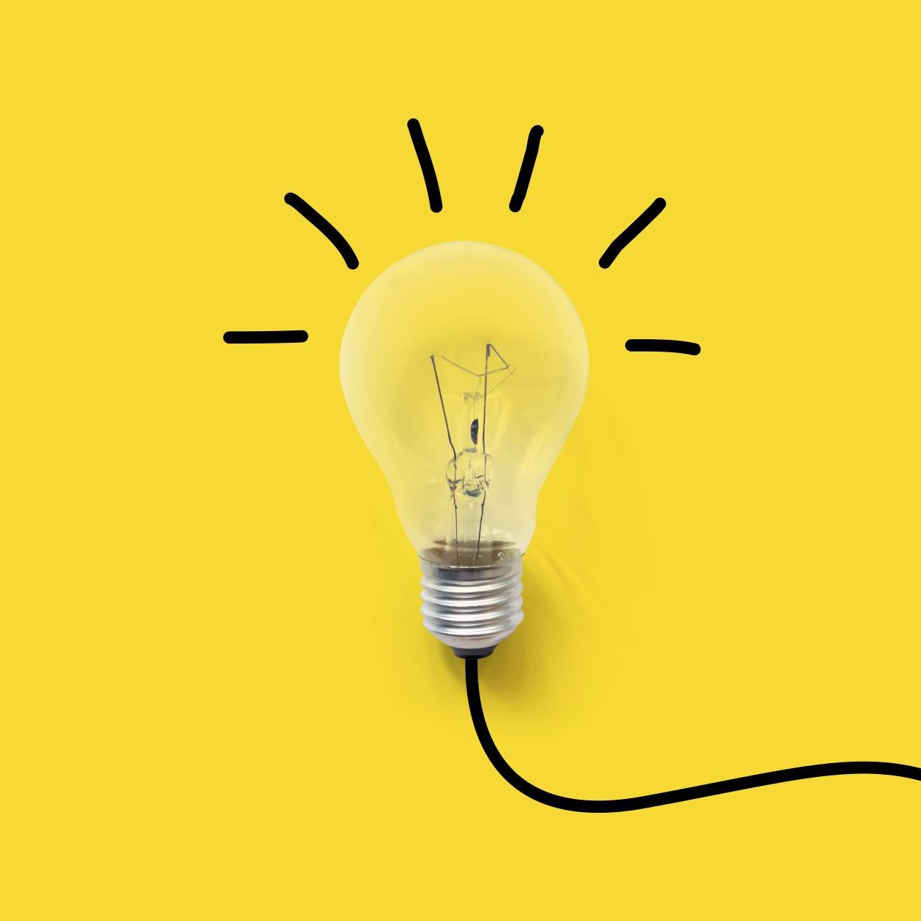
1. What are your goals?
Bring readers back to your site and read your article
Foster trust/relationships with your community
Source stories
Just get the information out there
Or something else?
Notes:
First, it’s helpful to think about your goals to help you decide what is a priority and what is it. Social media does take time and since that’s a finite resource, you can’t do everything. You’ll probably be doing a mix of these different goals, or maybe have something else entirely.

Slide 5
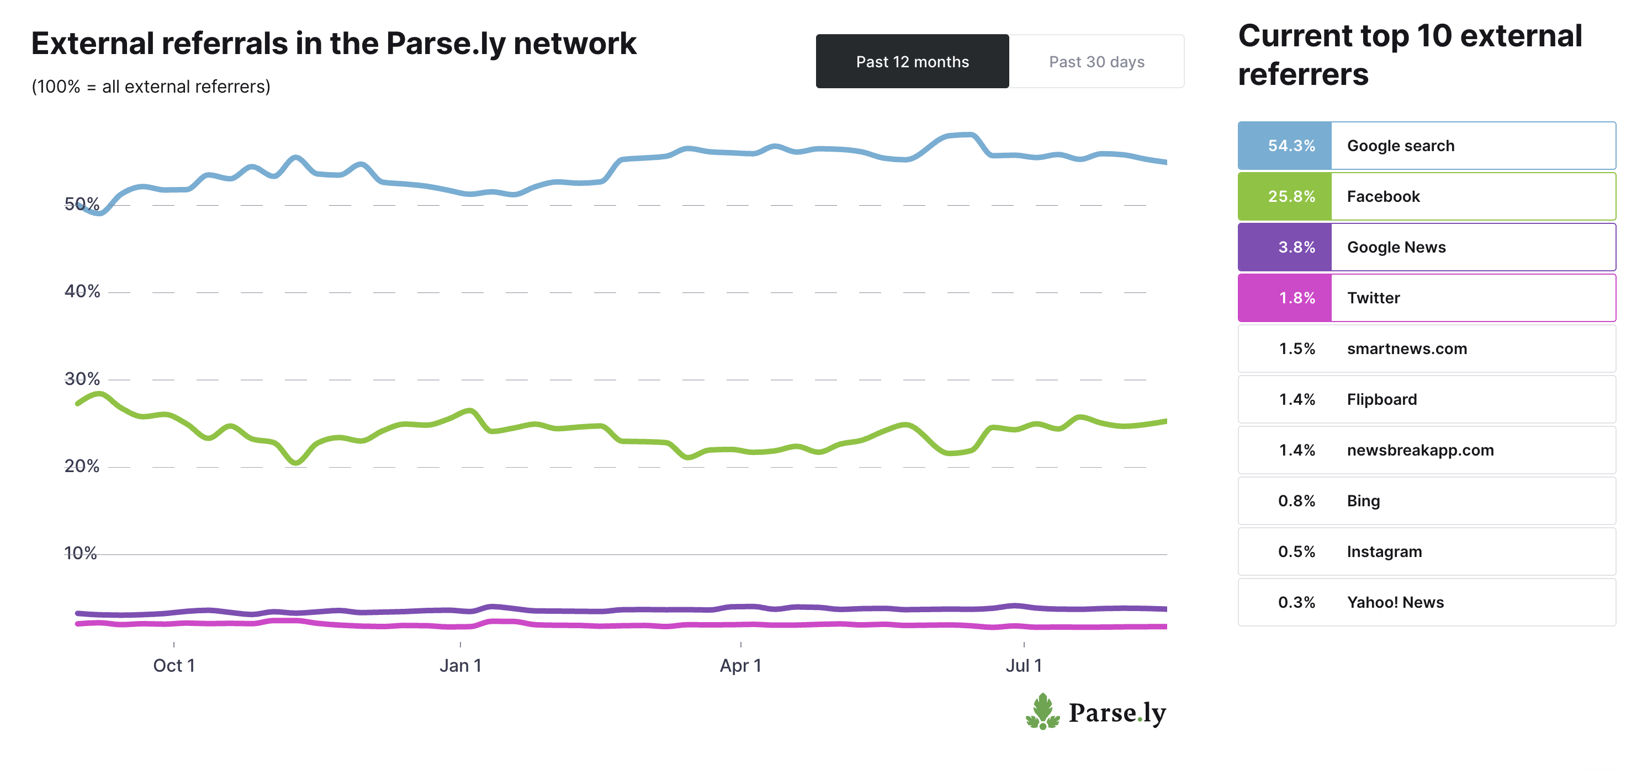
2. What is your broader audience strategy?
Email / newsletters
Search
Aggregators
Syndication
Polls / surveys
Comments
App
Policy impact
https://www.parse.ly/resources/data-studies/referrer-dashboard, taken on August 21, 2021
Notes:
Another thing to note -- social media should be part of a bigger audience strategy along with search and SEO, aggregators, newsletters, or syndication– and that’s really just if you’re mainly thinking about readership. In the Knight book, I talk about a few other tactics like surveys or comment sections that you could consider that are more about deepening engagement rather than just bringing in readers.

Slide 6
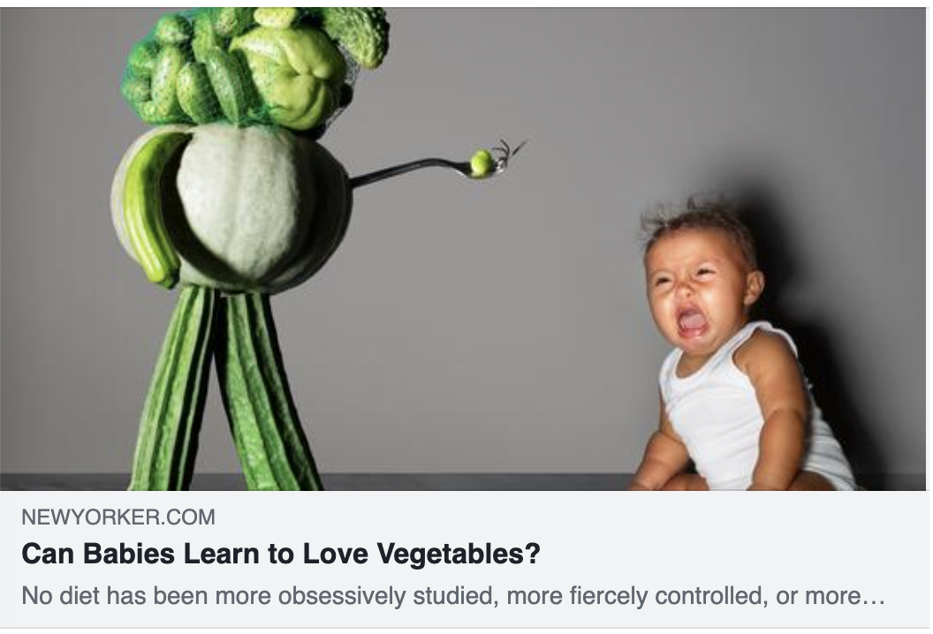
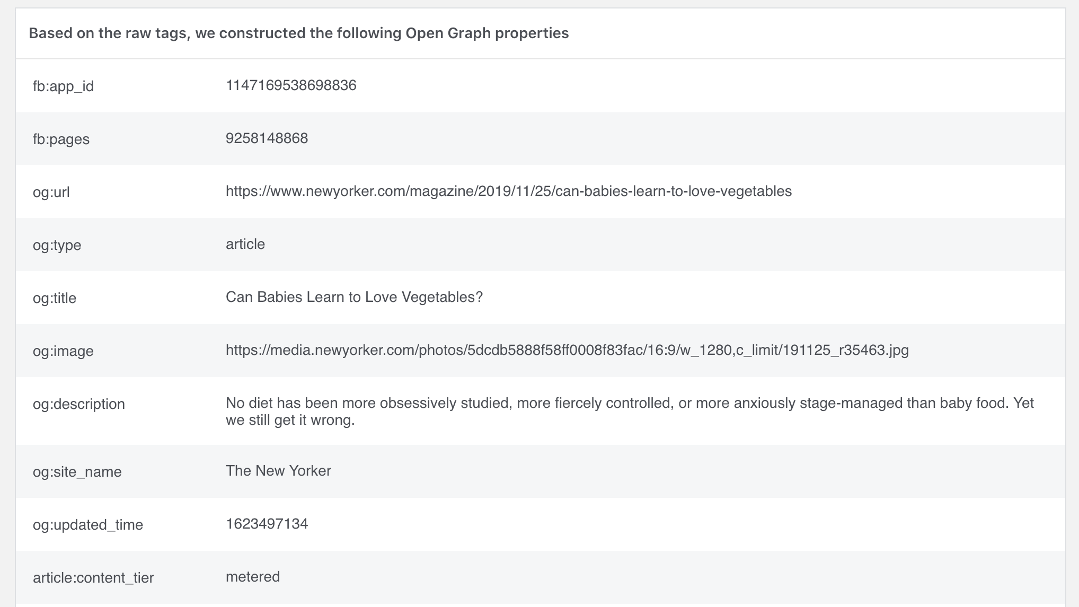
3. How are you packaging your stories?
Headline
Banner image
https://developers.facebook.com/tools/debug/?q=https%3A%2F%2Fwww.newyoker.com%2Fmagazine%2F2019%2F11%2F25%2Fcan-babies-learn-to-love-vegetables
Notes:
And the third thing – when you’re thinking about social media for your individual stories, I would really encourage you first and foremost to think about your headline and preview image. A good portion of your “social media” audience will likely – or hopefully -- be coming from other people sharing your content. For Knowable, that’s about 75% of our “facebook” traffic and 65% of our “twitter” traffic. So it doesn’t matter if I’ve crafted the best Facebook post in the history of the world for this one article – if my friend’s grandma’s coworker shares it on her own wall, that post isn’t going to follow
The headline and preview image are hardcoded into the metadata of your article, so it will follow the article around whenever anyone shares it. And depending on your content management system, you might even be able to write a social media specific headline if you want it to be something different than is on your site, or have more control over how that image displays.

Slide 7
A few key concepts

Slide 8
Key Concepts
Social space
“Brand voice” vs. personal use
Algorithmic
Notes:
After that, I just want to familiarize everyone with a few concepts that will cross most of the different platforms you’re dealing with, although there will be nuances to each one.
Social media is… social. For the most part, you will just be one type of poster squished between a whole smorgasbord of different sources. People are using it to keep up with friends and family, fandoms, all kinds of stuff. Unlike, say, search or direct traffic – when someone is going straight to your homepage – they may not know that they want to read your stuff. Click through rates are pretty low, and a lot of people will just read the headline.
Brand vs. personal – a publication might have a presence on a platform, or you as an individual might have a presence on a platform. You;ll probably be using the platforms a bit differently if it’s just you vs. having the “institutional” voice. Sometimes it’s a completely different account type, and you can set an account up to be more like a business account which will have more tools, vs. the standard ”profiles” that an individual would have.
Algorithmic -- most of them have some sort of machine learning going on under the hood to determine what gets recommended to who. A notable exception is the Twitter “latest tweets” feed, but even they also have an algorithmic “home” feed and other algorithmic features to help surface content. There’s not a ton of transparency around how they work, although there’s often some sort of publicly stated criteria and hundreds of marketing blogs trying to keep on top of it. Efforts to ”game” these algorithms often backfire because they get identified and engineered away– like, if you think of the super click baity Upworthy headlines of 2015. The fickleness of this is probably one of the most frustrating parts of trying to do social media.
On to other commonalities;
Hashtags -- Many of the platforms have some sort of hashtag component. It’s a way of marking a keyword or some other way that content should be categorized. They originated on Twitter, so they’re probably best known there; but Instagram is the one that is really using them more now.
Next commonality -- mentions / tags
There are two key ways you can “tag” another user in a post. One is through a mention, or a menchie, which is where their name is directly in the text of a post. The other is a photo tag -- like when friends post pictures and tag their friends and help train the Facebook AI. You might use them for different reasons on different platforms.
A few general guidelines would be --
research what people in your target audience are already using and use those (there are tools you can use but really, looking through existing posts is going to get you a good chunk of the way there);
be judicious in using them -- if you hashtag every word you will look like a spam bot.
There are big “common” hashtags and more “Niche” ones and you’ll probably need a mix of them.
Pro tip specifically for Twitter -- is to capitalize the individual words in a hashtag because it makes it easier for screenreaders
“Brand profile” vs a “person”
Without getting too deeply into it, it’s worth noting that a lot of the platforms have a brand or business type account, which are designed for entities, not necessarily individual people, or you might set up an account that’s representing the whole publication instead of an individual person. Business accounts also usually include a lot more analytics tools than just a standard user profile would. The border between the “brand” and the “person” type accounts can be fuzzy -- an easy example is that a reporter might have a strong twitter presence on their own that’s separate from their publication, and a very private Facebook account; but then you might be using a private Facebook account to engage in Facebook groups. Even if you aren’t planning on building a big robust influencer brand out of yourself after this, I would still recommend doing some digital security tuneups https://onlineharassmentfieldmanual.pen.org/

Slide 9
Other commonalities
Mobile
Hashtags
Mentions / tags
Notes:
Some other commonalities:
1. A lot of people use social media on their phone. They might be out and about, in the line at the grocery store, scrolling through instagram before going to sleep. It’s a relatively tiny screen. And they’re probably going through it vertically, not horizonally.
2. Hashtags -- Many of the platforms have some sort of hashtag component. They originated on Twitter, so they’re probably best known there; but Instagram is the one that is really using them more now.
Some quick tips
research what people in your target audience are already using and use those; if your scientist sources are really active on social media, they’re probably already using them (there are tools you can use but really, looking through existing posts is going to get you a good chunk of the way there);
be judicious in using them -- if you hashtag every word you will look like a spam bot.
Pro tip specifically for Twitter -- capitalize the individual words in a hashtag because it makes it easier for screenreaders
Next commonality -- mentions / tags
There are two key ways you can “tag” another user in a post. One is through a mention, or a menchie, which is where their name is directly in the text of a post. The other is a photo tag -- like when friends post pictures and tag their friends and help train the Facebook AI. You might use them for different reasons on different platforms.
A few general guidelines would be --
“Brand profile” vs a “person”

Slide 10
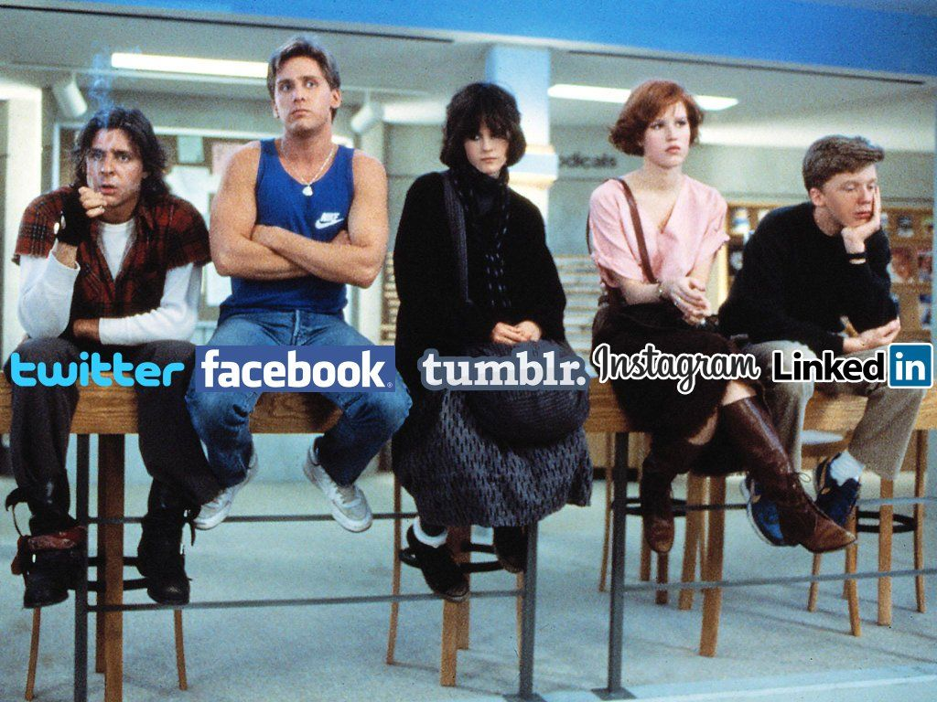
The platforms
Notes:
All right, now I am going to give a very quick survey through some of the major platforms. Please keep in mind that these are rough guidelines, not gospel, and I am just scratching the surface

Slide 11
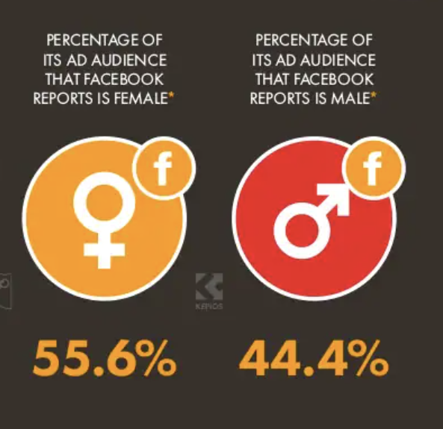
Quick caveat
United States
World wide
Source: https://www.hootsuite.com/pages/digital-trends-2021
Notes:
One quick caveat -- There are a lot of differences in how people use social media based on where they are in the world, and even pulling together “quick demographic information” can be tricky and hard to generalize. For example. globally Facebook’s audience skews male, but when you look at the United States, women are the dominant group. And then if you start to dig into smaller geographic reion, or more psychometric categorizations, there’s going to be a lot of nuance to the specific audiences. So wherever you are operating, I would encourage you to dig deeper. I pulled these stats from a 2021 report by hootsuite and the link will be in the presentation when it gets sent around. And I really would welcome you to chime in on the chat if you see trends or patterns that are different in your region so that participant’s today can benefit from that knowledge as well.

Slide 12
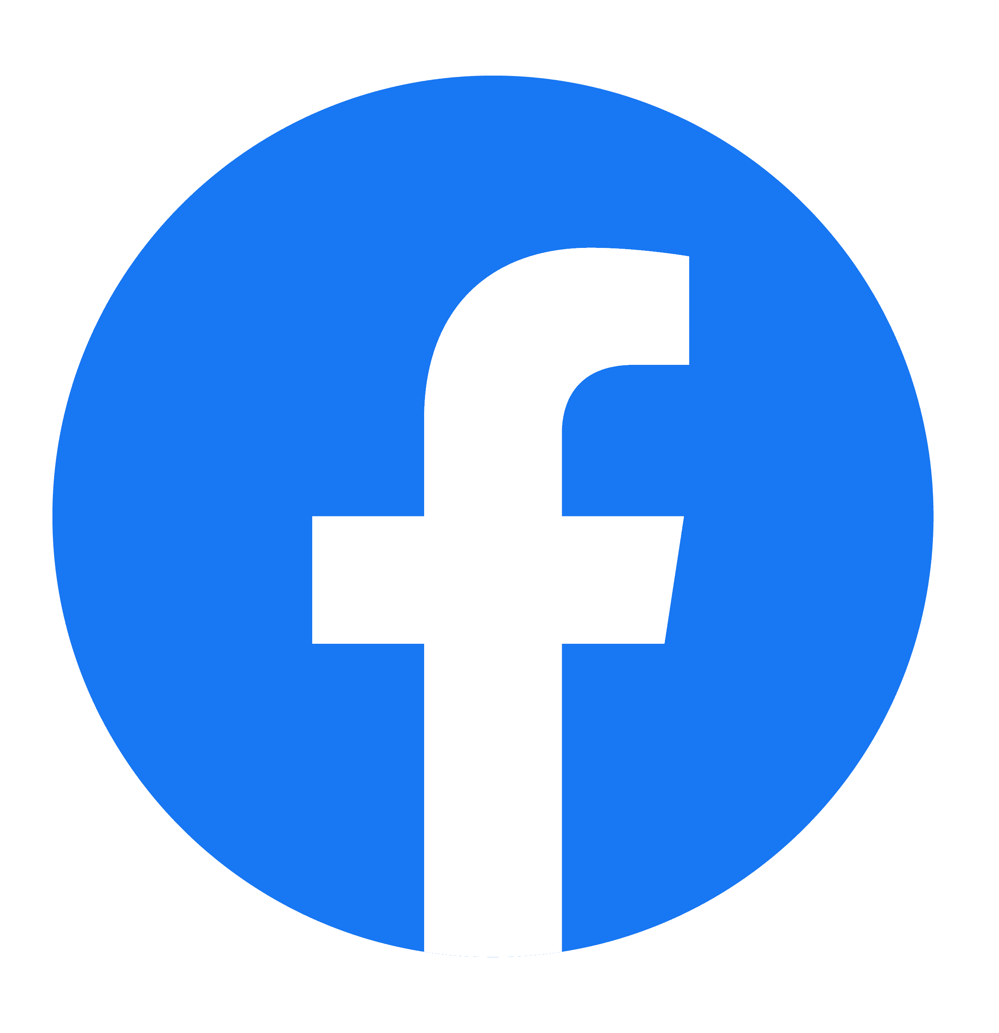
Facebook
Broadest audience
Facebook pages & posts
Facebook groups
Feed order | Algorithm
Hashtags? | Sometimes
Easily link to website? | Yes
Lifespan of a post | 6 hours
Notes:
Facbeook -- the big one. Facebook has more monthly users than the population of China and India combined. If you look across the user base, it’s pretty well distributed across all ages -- but if someone in the 55-64 or 65+ demo is on a social media site, it’s most likely Facebook. Facebook cuts across more demographics than any other platforms also in terms of education and urban/suburban/rural divide.
Key product to know about:
Facebook pages -- Most publisher content is coming through a Facebook page. A lot of best practice sites will recommend something much shorter, like 50-80 characters, but we at Knowable have been posting stuff that’s much longer and seen that do better than our shorter stuff, so it’s really worth exploring more with your own audience. Images and video tend to get pushed on Facebook, although those aren’t necessarily driving traffic back to your site.
Facebook groups -- In the last few years, Facebook has really gravitated towards “groups” as a main way of engaging users on the platform. If you are considering building one, keep in mind that groups take moderation to keep them lively and engaged and civil, so be prepared to invest time and make sure you know why you’re starting one. A less intensive way of tapping into groups would be contacting or partnering with an existing one.

Slide 13
Twitter
Short, quick and newsy
Power users
Tweets – 280 characters (237 with a link)
Threads
Quote tweets
Tweetdeck
Feed order | Latest = reverse chronological Home = Algorithmic
Hashtags | 1-3
Easily link to website? | Yes
Lifespan of a post | 18 minutes
Notes:
Twitter! The preferred platform of journalists. Quick and newsy.
One interesting report from a Pew study-- 80% of all tweets come from about 10% of users.
Key products to know:
Tweets – 280 characters, less if you include a link
Threads -- If you’re posting multiple tweets that weave together into a narrative, you’lll want to keep these in a “thread”
Quote Retweet – is a way to “retweet” someone while putting your own commentary on I
I would really recommend tryingTweetdeck -- currently a free product that’s great for a Twitter power user. If you find just a regular feed overwhelming, this could either help or drive you even more up the wall, depending on how you use it. It’s a way that you can set up feeds for different hashtags, or lists, or even if you just want to follow one feed of just your own publication you can do that

Slide 14
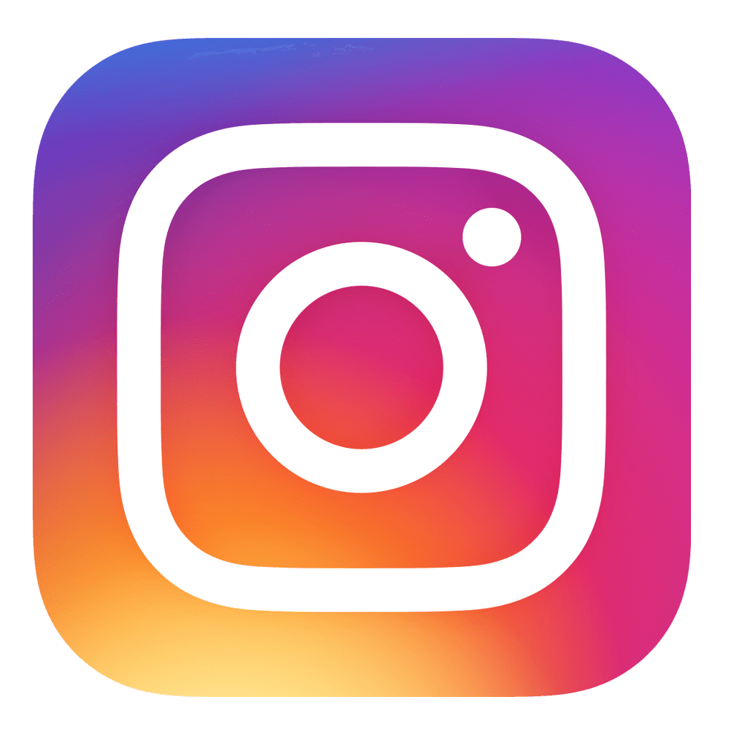
Instagram
Runs younger – millennial & gen Z
Aspirational / beautiful imagery
“slideshows”
Stories
Videos/reels
Hashtags are really important
Feed order | Algorithm
Hashtags | 11
Easily link to website? | No
Lifespan of a post | Post: 24-48 hours Story: 24 hours
Notes:
Instagram -- it’s owned by Facebook. THe audience tends to be a bit younger -- think millennials and Gen Z, so teens through late 30s, although the userbase is broadening.
Known for really beautiful or aspirational imagery. Although Will note that there has been shift, particularly in the last year, to having these all text, multiple image carousel posts that are almost like small powerpoints explaining an issue.
Besides just regular posts two conetnt types to know about.
Stories: I mentioned these earlier it’s an ephemeral piece of content, meaning it’s set to expire after 24 hours. These can be videos, a still image, or you can share posts into your story. There are a lot of really fun native tools in Stories like polls, quizzes and questions that help make them more interactive.
Reels: Instagram is pushing this one pretty hard recently -- it’s a TikTok clone, with very short, fun videos.

Slide 15
Reddit
Front page of the internet
Largely younger and male
Organized into subreddits
Permission, not forgiveness
AMA – Ask Me Anything
Feed order | Upvote/Downvote
Hashtags | No
Easily link to website? | Yes (if mods permit)
Lifespan of a post | 4 hours (debatable)
Notes:
Reddit is the front page of the internet. In general, the majority of users are young & male, although there may be pockets where this isn’t the case.
It’s actually made up of thousands of subreddits dedicated to a particular topic. Posts can be upvoted or downvoted.
If there’s one thing to take away about Reddit, it would be -- permission is always better than forgiveness. The subreddits are moderated by volunteer mods who get to make the rules for each subreddit, and it will different for each one. A lot of them are very hostile to “brands” coming in, which includes publishers. I’ve been told by at least one subreddit that if I posted anything there, they would just block our whole domain so no one could post stuff.
Products to be aware of:
Content notes:
Lifespan of a post
AMA or Ask me Aything is an interactive online Q&A

Slide 16
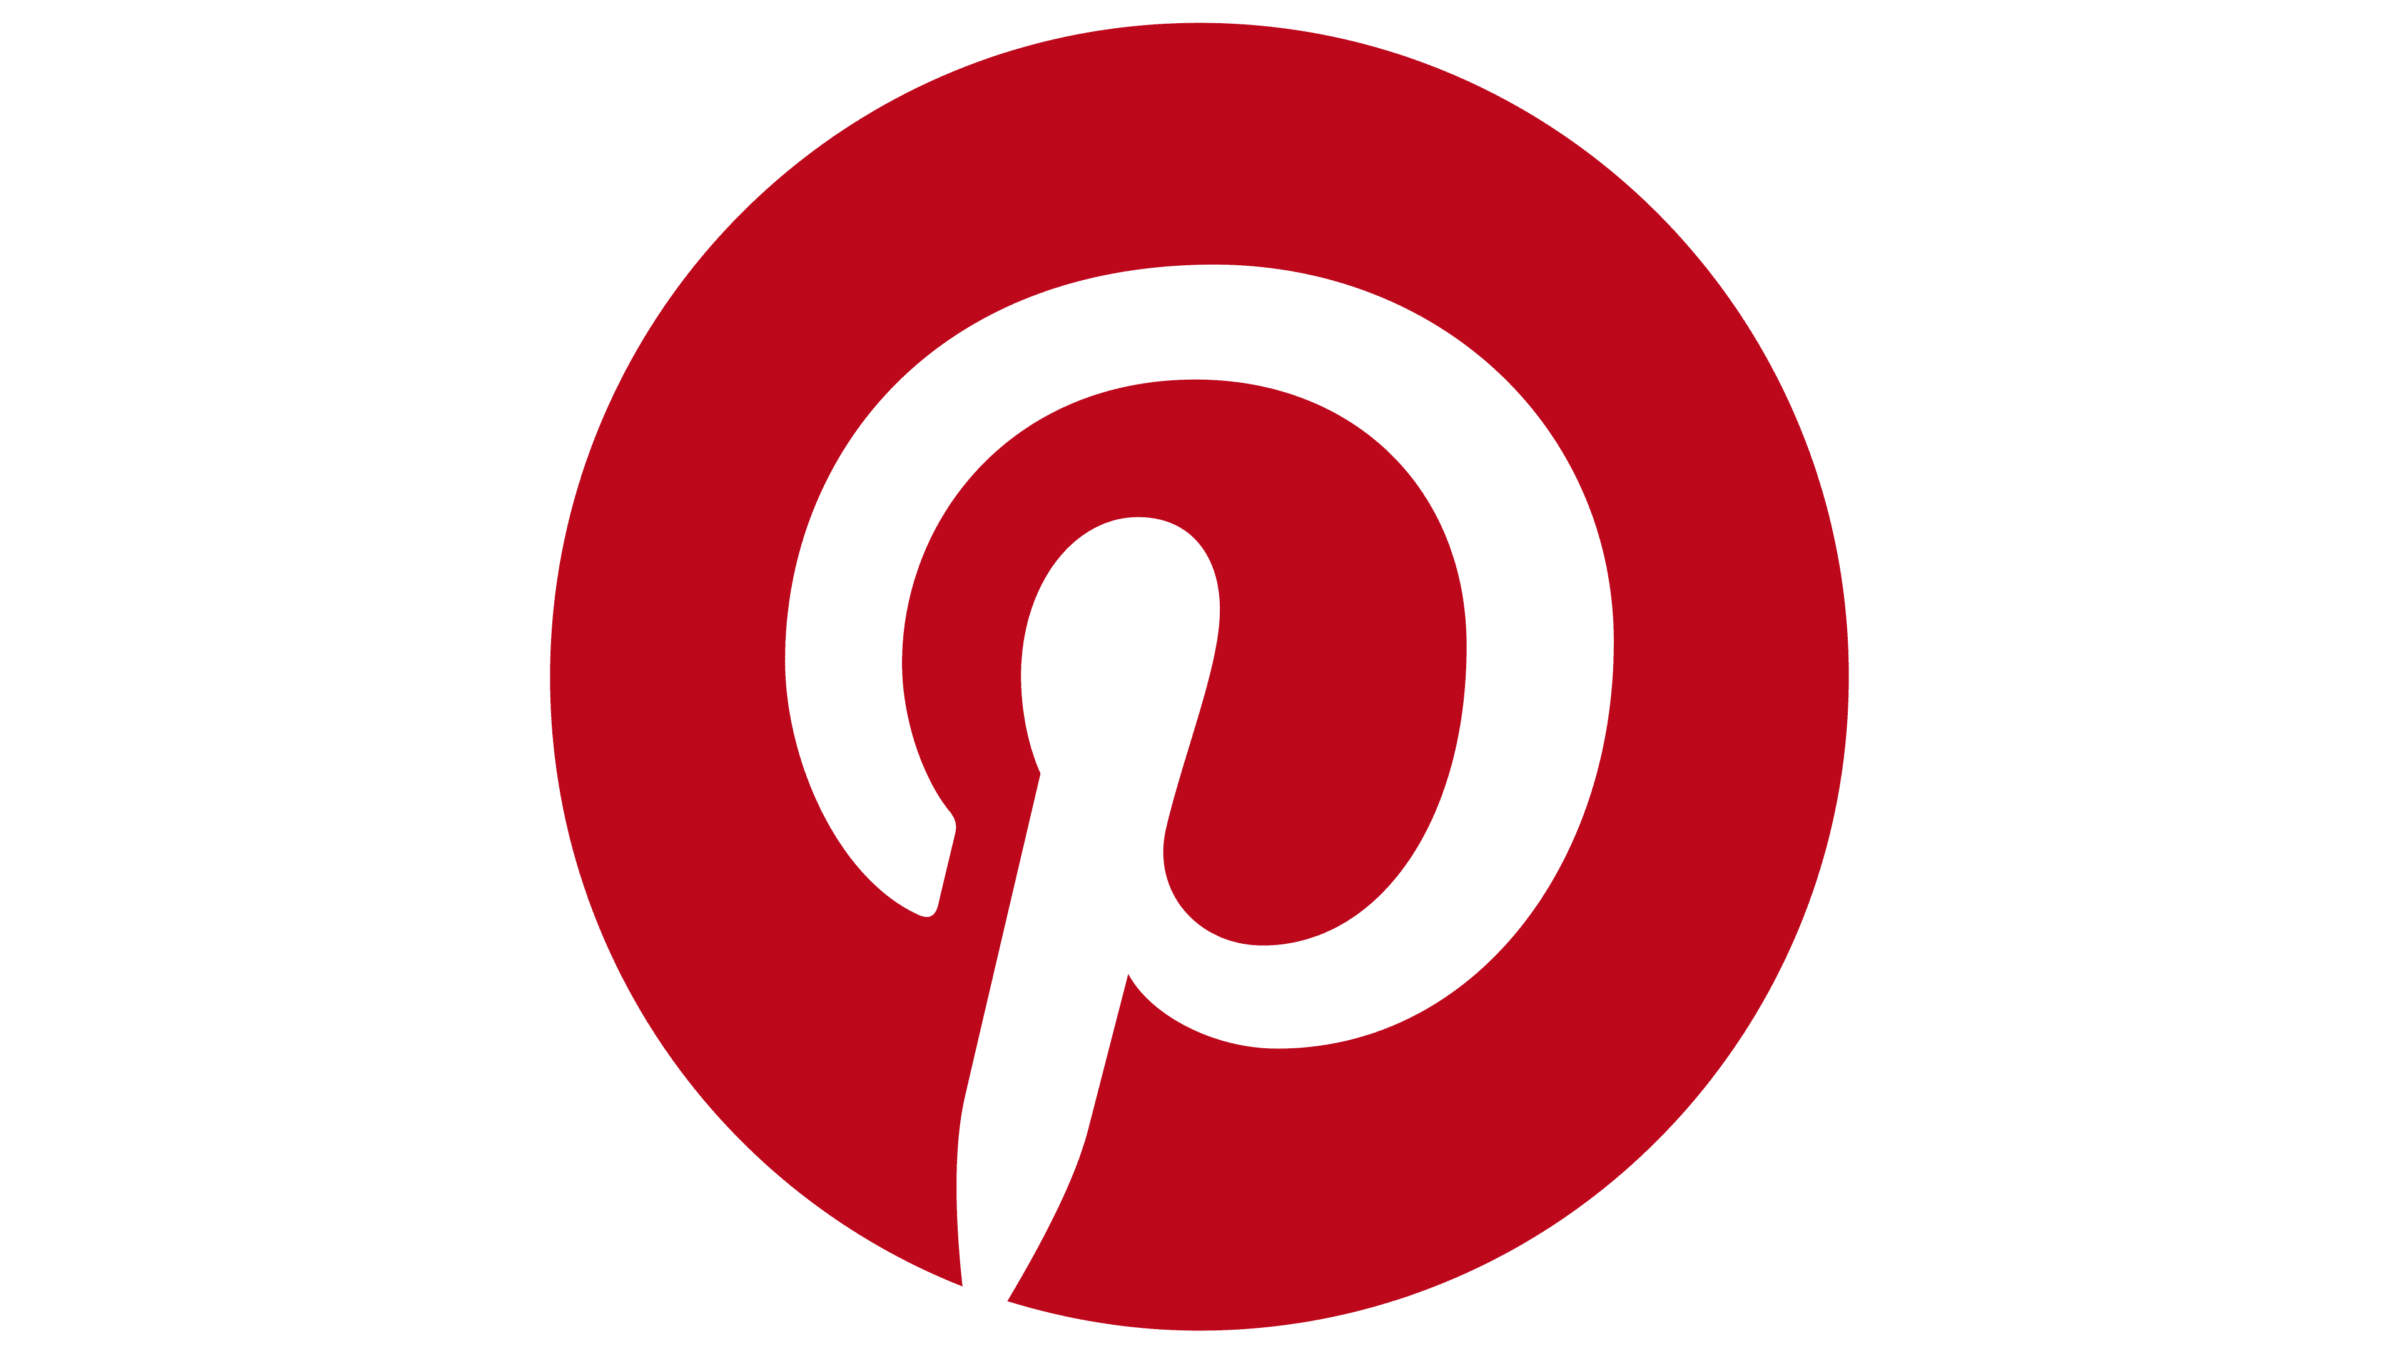
Pinterest
Overwhelmingly female
Often used by lifestyle/fashion publications
“Pins” organized on “Pinboards”
Discover OR save content
Optimizing for search
Feed order | Algorithmic
Hashtags | Yes
Easily link to website? | Yes
Lifespan of a post | 4 months
Notes:
Pinterst is overwhelmingly female, and spans the age groups.

Slide 17
LinkedIn
Business / work / career focus
Highly educated user base
News curation
Feed order | Algorithm
Hashtags | 1-3
Easily link to website? | Yes
Lifespan of a post | 24-48 hours
Notes:
LinkedIn, owned by Microsoft The resume of the internet. [Use the dog meme]. The user base for this set tends to be more highly educated -- think white collar professionals.
Key products:
Business page / showcase page -- you can set up a page for your publication, and if you have a parent organization, this can be a subset called a showcase page.
News curators
Content notes:
This meme, which is actually a derivative of one written by an Ogilvy copywriter, encapsulates the sort of tone you tend to see on the platform.
Good for business coverage, industry coverage, work-related stuff

Slide 18
TikTok
Young audience
Shortform, vertical video
Scary accurate algorithm
Feed order | Algorithm
Hashtags | Yes
Easily link to website? | No
Lifespan of a post | Minutes, unless viral
Feed order
Hashtags
Easily link to website?
Lifespan of a post
Notes:
Scary good algorithm

Slide 19
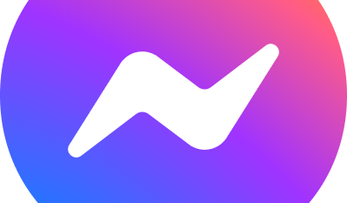
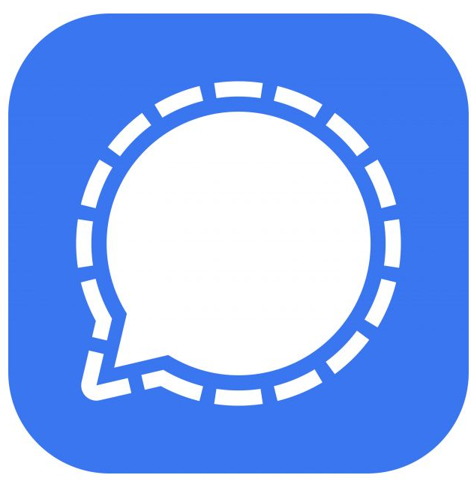
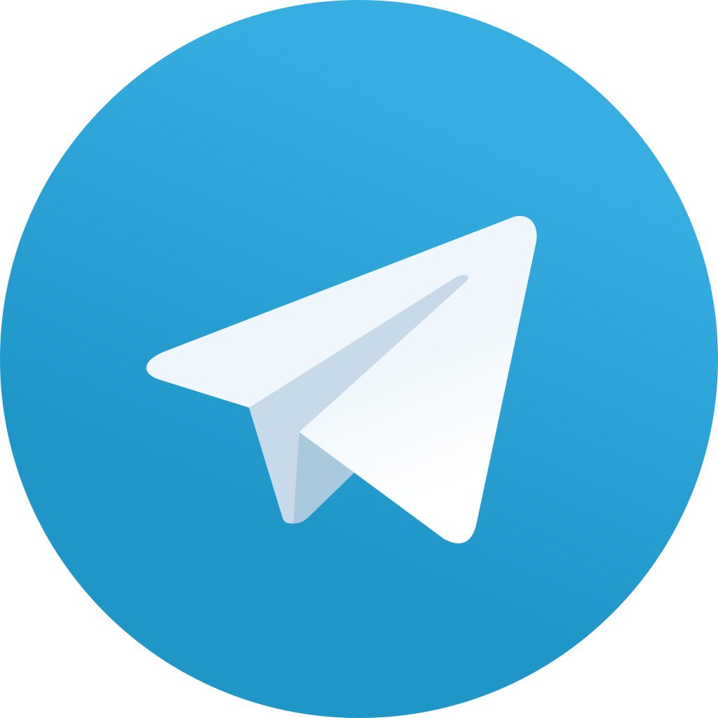
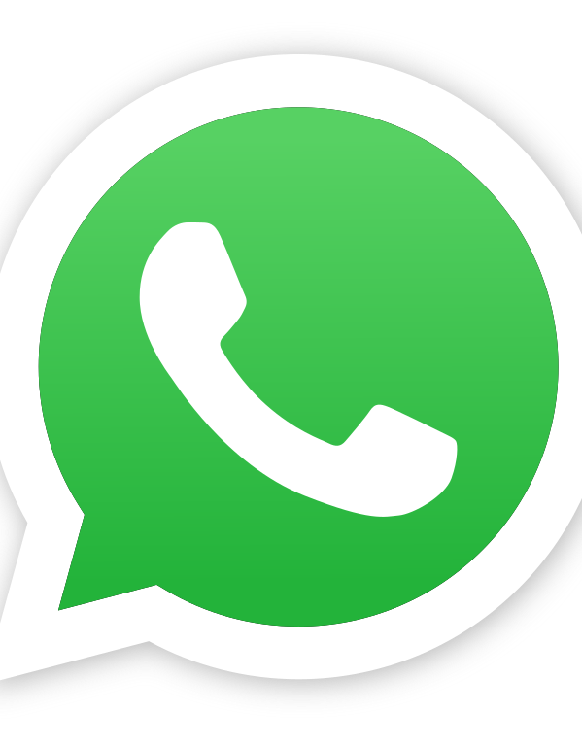
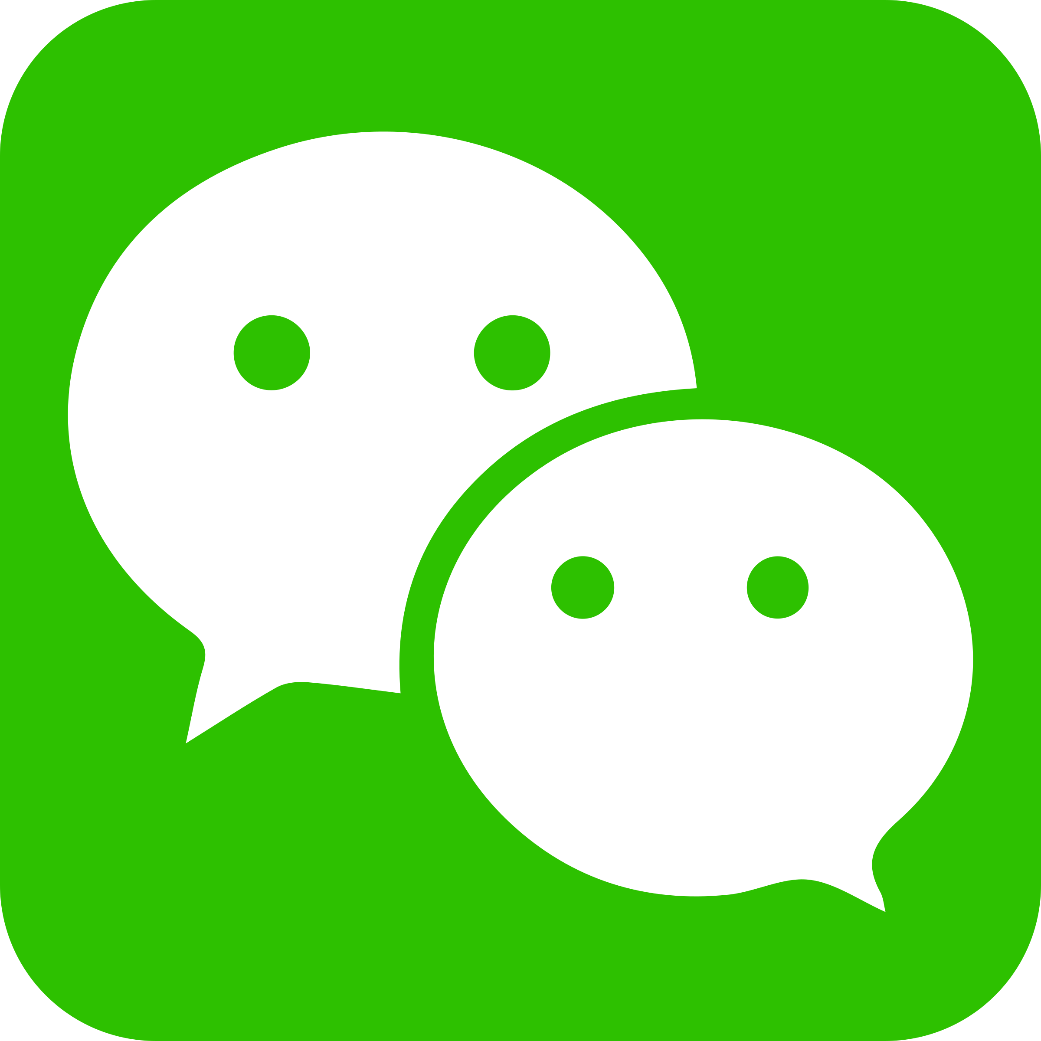
Messaging apps
Notes:
I do want to flag that messaging apps are also huge, particularly WhatApp outsid of the united States. I haven’t personally done a lot of work with trying to do audience engagement through messaging apps, but I do want to make sur eyou have it on your radar.

Slide 20
Honorable mentions
Snapchat
Nextdoor
Tumblr
Clubhouse
YouTube
Notes:
Snapchat – still top app for teenagers / Gen Z
Nextdoor – ifyou’re doing local news
Tumblr – this microblogging platform is still around but not nearly as popular
Clkubhouse – audio only platform. (You could argue that Discord is in a similar vein although not quite)
YouTube – whole other ball game. It is one of the top sources of news for a lot of people so it is worth keeping in mind

Slide 21
One last PSA
PEN American Online Harassment Field Manual: https://onlineharassmentfieldmanual.pen.org/
Notes:
Even if you aren’t planning on building a big robust influencer brand out of yourself after this, I would still recommend doing some digital security tuneups https://onlineharassmentfieldmanual.pen.org/

Slide 22
Additional resources
Social Media and Reader Engagement – KSJ Science Editing Handbook https://ksjhandbook.org/social-media-reader-engagement/
Social Media Geekout Newsletter by Matt Navarra https://www.getrevue.co/profile/geekout
Taylor Lorenz https://twitter.com/TaylorLorenz
Platformer by Casey Newton https://www.platformer.news/
Journalism Growth Club https://glow.fm/journalism-growth-club/

Slide 23
Thank you!

